Slide 1


Backend, Frontend, and DLC Content Management
Day II

Slide 2
Exploring the DLC Content Management System
Session - 1
Learning Objectives:
  Navigate and explain the structure and functionality of the landing page, login page, dashboard, and profile management modules.
  Demonstrate how to access, search, and interact with digital learning content through the frontend.
  Manage user profiles, passwords, and display preferences from the backend dashboard.

Slide 3
What is DLC Content Management?
DLC (Digital Learning Content) Management System is a platform designed to store, organize, deliver, and manage digital learning materials (video content)
Purpose:
  Facilitate easy access to learning materials for users.
  Support multi-language and multi-sector content delivery.
  Provide analytical insights about the digital content
  Simplify content updates and user management for administrators.

Slide 4
Core Components:
  Landing Page – Public interface for browsing and searching content.
  Login Page – Access point for authenticated users.
  Dashboard – Administrative overview and analytical reports.
  Profile Management – User personalization and security controls.
  Employee Management – Manage system users.
  Customer Management – View and monitor customer.
  Content category Management – Define and organized content area.
  Digital content Management – Upload and manage actual learning materials.
This session covers the first four components: the landing page, login page, dashboard, and profile management modules

Slide 5
Landing Page (Public Use Only)
Purpose
  The Landing Page serves as the public interface of the Digital Learning Center (DLC) system.
  It allows unauthenticated users to explore available content categories, search for digital content, and download the mobile app.
  Acts as a gateway to learning materials and mobile accessibility.
Accessing the Landing Page
  Open any browser.
  Type the system URL (https://www.dlc.gov.et ).
  The landing page will load as the default interface.

Slide 6
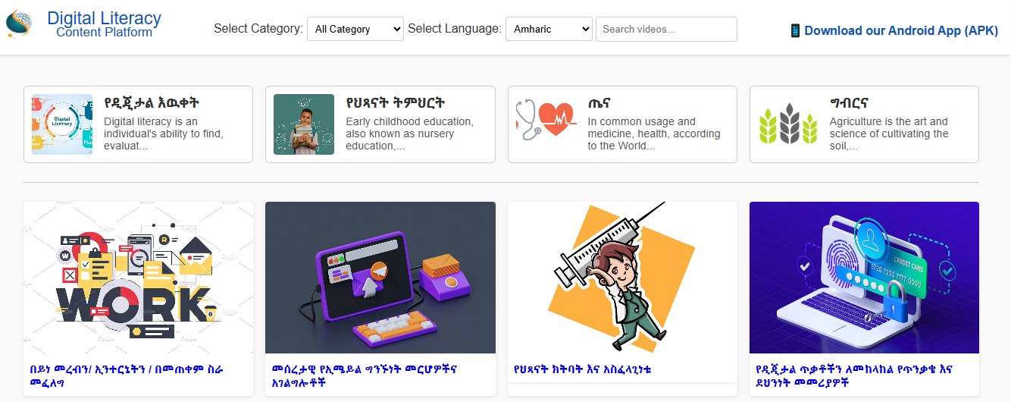

Slide 7
Structure of the Landing Page
Header Section
  Contains the search bar.
  Includes a link to download the APK file for the mobile version.
Content Category Section
  Displays a list of content categories, each with:
    Small image/icon
    Category title
    Short description
Digital Content Section
  Shows available videos similar to YouTube layout:
    Thumbnail image
    Title
    Short description

Slide 8
Search Functionalities
Simple Search
  Type a keyword in the search bar → system filters videos by title.
Advanced Search
  Select filters such as:
    Category
    Language
    Keyword/Search Query
The system will display videos matching all selected filters.

Slide 9
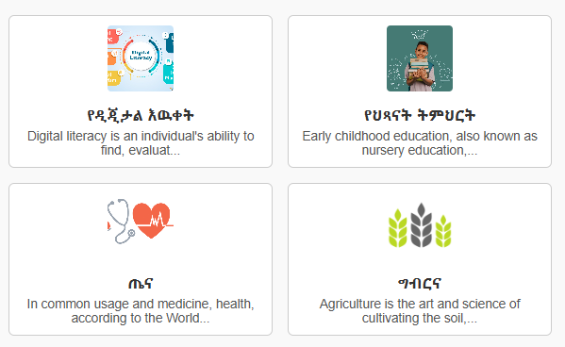
Content Category Interaction
Click a category → view all related videos.
Further filter results by language or keyword on the same page.

Slide 10
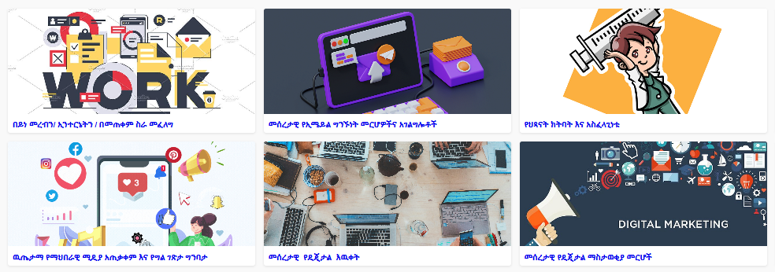
Digital Content Playback
Click a video → open the video player page.
The main video plays in the center.
Related videos appear in a sidebar.
Clicking a related video replaces the main playback window.

Slide 11
Exercise 1: Explore the Landing Page
Instructions:
  Open the DLC system in a browser.
  Perform a simple search (e.g., type “ህጻናት”).
  Use advanced search — select a category and language filter.
  Play a video and note the related video suggestions.
Expected Outcome:
  Participants can navigate the landing page and effectively search and play content.

Slide 12
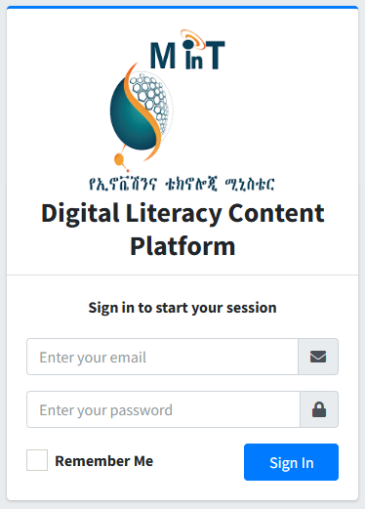
Login Page
Purpose
  The Login Page allows registered users (administrators and other) to securely access the backend dashboard.
Steps
  Open the system URL: https://dlc.gov.et/public/login
  Enter your email and password.
  Click Sign In.
  The system redirects to the Dashboard upon successful authentication.
Note:
  If login fails, verify credentials or reset the password as per system policy.

Slide 13
Exercise 2: Access the Dashboard
Instructions:
  Log in using provided training credentials.
  Observe the dashboard layout and note visible modules.
Expected Outcome:
  Participants can log in and identify backend dashboard components.

Slide 14
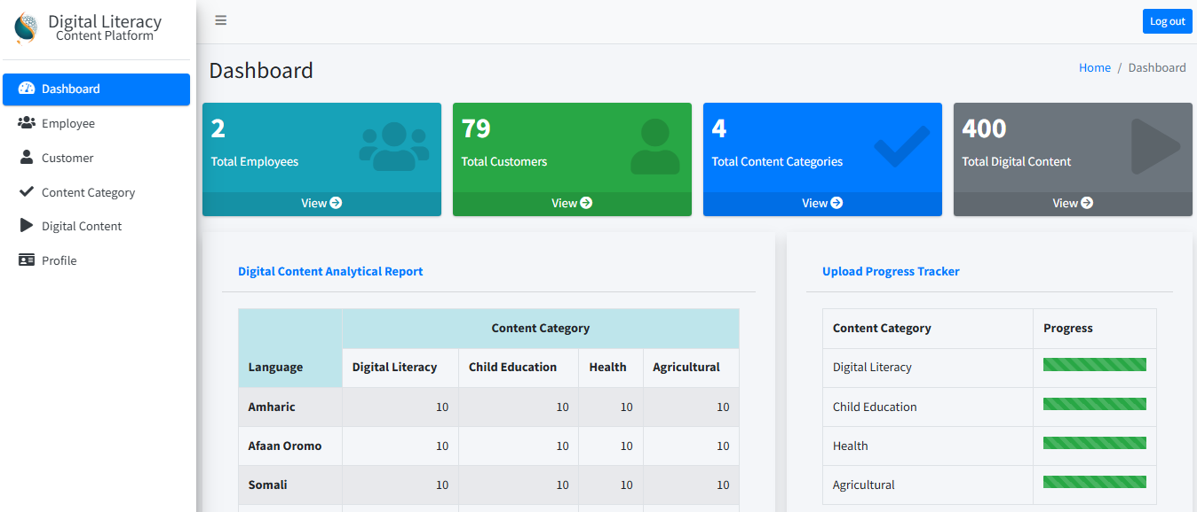
Dashboard
Purpose
  The Dashboard provides an overview of system metrics and administrative tools.

Slide 15
Dashboard Components
Display Counters
  Number of total employees
  Number of total customers
  Total number of content categories
  Total number of digital content uploaded
Digital Content Analytical Report
  Table showing number of videos by category and language.
Upload Progress Tracker
  Progress bar showing content upload completion for each category:
    Expected total uploads vs actual uploaded count

Slide 16
Exercise 3: Analyze the Dashboard
Instructions:
  Explore the dashboard counters and note key system statistics.
  Identify which content category is least complete based on the upload tracker.
Expected Outcome:
  Participants can interpret and explain dashboard metrics.

Slide 17
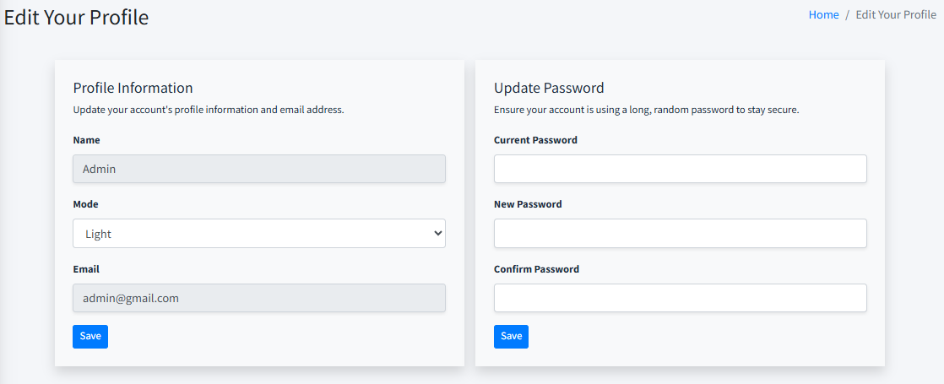
Profile Management
Purpose
  Allows authenticated users to manage personal settings and update account credentials.

Slide 18
Available Functions
Theme Settings:
  Switch between light or dark mode.
Password Management:
  Enter current password.
  Enter and confirm new password.
  Click Save.
Password Policy:
  Minimum 8 characters
  At least 1 uppercase letter
  At least 1 lowercase letter
  At least 1 digit
  At least 1 special symbol

Slide 19
Exercise 4: Update Profile Settings
Instructions:
  Change the dashboard theme (light ↔ dark).
  Attempt to update your password following the password policy.
Expected Outcome:
  Participants can update user preferences and securely change passwords.

Slide 20
Discussion & Q&A (10 minutes)
What challenges might users face while searching content?
How can the dashboard data improve content management?
What password policy enforcement mechanisms are most effective?

Slide 21
Exploring the DLC Content Management System (continue)
Session - 2
Learning Objectives:
  Manage employee and customer profiles within the DLC admin portal.
  Create, edit, and organize content categories for multilingual access.
  Upload and manage digital learning videos and related media.
  Understand metadata management and how it supports search and analytics.
  Practice secure and consistent data entry standards for all content types.

Slide 22
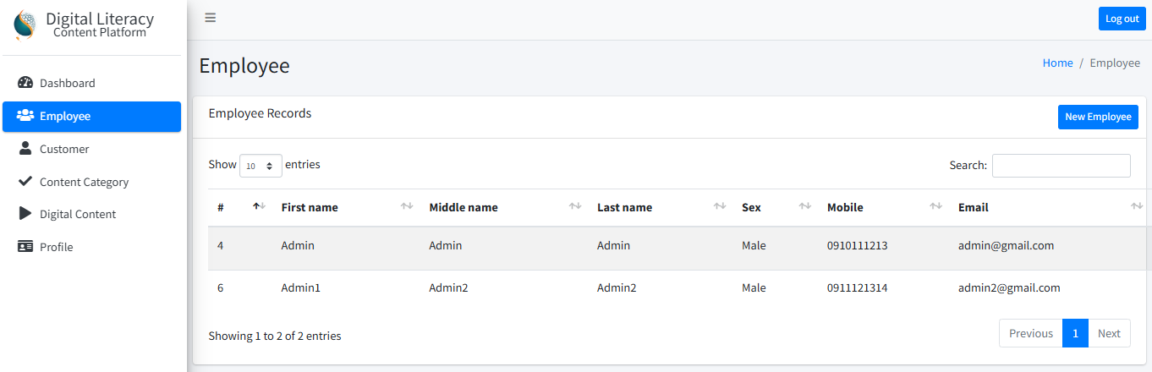
Employee Management
Purpose:
  To manage system users who have administrative or content management roles. This module allows authorized users to add, edit, or remove employee accounts with defined permissions and roles.

Slide 23
Employee Management - Operations
Steps:
  From the sidebar, click “Employee.”
  The system displays a list of registered employees.
  Perform the following operations:
    Add New Employee: Fill out personal and role-based metadata.
    Edit Employee: Update profile information and save changes.
    Delete Employee: Remove outdated or duplicate profiles.
    Search Employee: Locate specific users using the search bar.

Slide 24
Exercise 1 : Hands-on Task
Add one new employee profile using the provided metadata.
Edit an existing profile (e.g., update contact info).
Search for a specific employee by name.
Delete a test account safely.

Slide 25
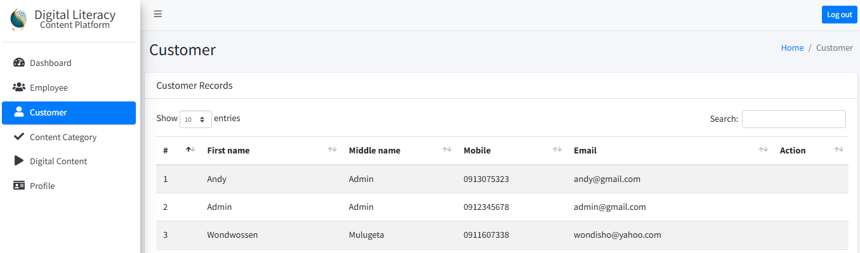
Customer Management
Purpose:
  To view and monitor customer (mobile app user) accounts who access the DLC content.
  This helps administrators understand user engagement levels and troubleshoot login or profile issues.

Slide 26
Customer Management - Operations
Steps:
  From the sidebar, click “Customer.”
  The system displays all registered mobile app users.
  Use the search box to filter users by name, mobile, or email.
Note: Editing and deleting customer accounts are restricted — customers manage their own profiles from the mobile app.

Slide 27
Exercise 2 : Hands-on Task
Search for a specific customer profile by mobile number or name.
Observe the data structure (what info is displayed for each user).

Slide 28
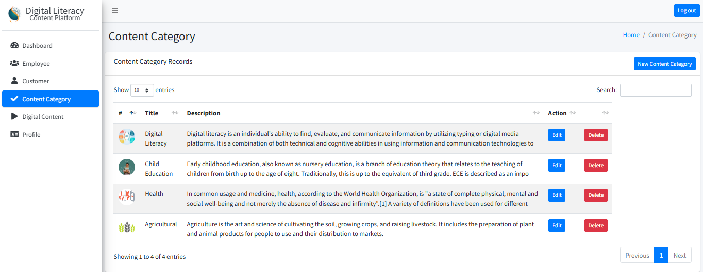
Content Category Management
Purpose:
  To define and organize content areas (e.g., Health, Education, Agriculture) so users can browse digital learning materials efficiently.

Slide 29
Content Category Management - Operations
Steps:
  Click “Content Category” from the sidebar.
  The system shows all categories currently available.
  Perform the following:
    Add New Category: Provide multilingual titles, descriptions, and a category image (rename field as Category Icon for clarity).
    Edit Category: Modify existing category details.
    Delete Category: Remove outdated categories.
    Search Category: Use the search bar to find specific categories.

Slide 30
Exercise 3 : Hands-on Task
Add a new content category titled “Digital Skills” with English and Amharic titles.
Upload a relevant icon.
Edit an existing category to update its description.
Search for the newly added category.

Slide 31
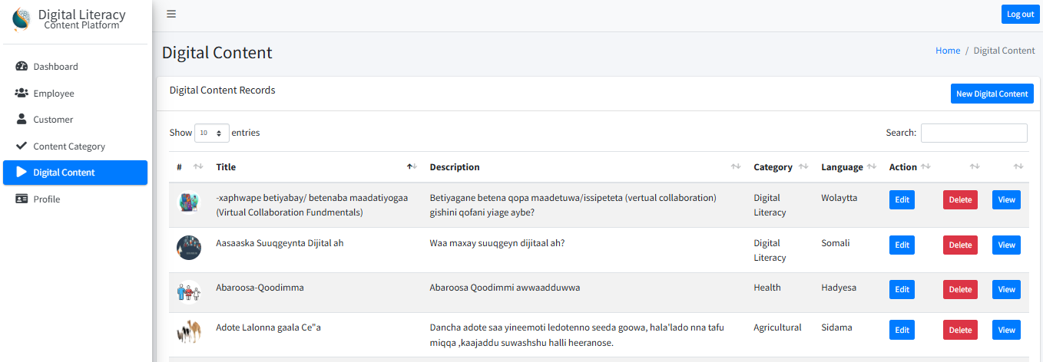
Digital Content Management
Purpose:
  To upload and manage actual learning materials (videos) under defined categories and languages.

Slide 32
Digital Content Management - Operations
Steps:
  Click “Digital Content” from the sidebar.
  The system lists all available learning contents.
  Perform the following:
    Add New Digital Content: Fill metadata and upload media:
      Title (based on language) , Description, Category selection, Language, Upload video file, and Attach video poster (thumbnail)
    Edit Digital Content: Update metadata or replace video/poster.
    Delete Content: Confirm deletion with the system alert.
    Search Content: Filter by title, category, or language.
    View Content: Preview uploaded video with play/pause, volume, full-screen, and picture-in-picture controls.

Slide 33
Exercise 4 : Hands-on Task
Upload one sample video under a new category.
Edit its description and language metadata.
Test the search function using part of the video title.
Play the uploaded video to verify streaming functionality.

Slide 34
Q&A and Reflection (15 minutes)
What metadata fields are critical for content search and analytics?
How can administrators ensure content is inclusive and accessible?

Slide 35
Backend & Frontend Editing
Session - 3
Learning Objectives:
  Understand the Laravel folder structure and how backend and frontend components interact.
  Navigate and edit key parts of the system such as the landing page, login page, dashboard, and profile management sections.
  Modify backend logic (controllers, models, routes) and frontend views safely.
  Configure and test database connections within the Laravel environment.

Slide 36
Code Overview
Laravel Project Structure Overview
  Laravel follows the MVC (Model-View-Controller) pattern:
    Model – Represents the database structure and logic.
    View – Manages what users see (HTML + Blade templates).
    Controller – Connects models to views and handles logic.
    Routes – Define which controller methods are called for specific URLs.
Key Folders:
  /app/Models → Database models
  /app/Http/Controllers → Backend logic
  /resources/views → Frontend pages (Blade templates)
  /routes/web.php → Web route definitions

Slide 37
Exercise 1:
Open the Laravel project folder in VS Code.
Identify and open the above folders.
Discuss the purpose of each folder briefly.

Slide 38
Database Connection Setup
Configuring Database Connection
  Locate the .env file in the root folder.
  Update database credentials:
    DB_CONNECTION=mysql
    DB_HOST=127.0.0.1
    DB_PORT=3306
    DB_DATABASE=dlc_db
    DB_USERNAME=root
    DB_PASSWORD=
Save and test with:
  php artisan migrate:status

Slide 39
Exercise 2:
Check if the connection works by running a test query or viewing data in phpMyAdmin.

Slide 40
Routing Overview
How Laravel Handles URLs
  All web routes are stored in /routes/admin.php or /routes/web.php.
  Example:
    Route::get('/dashboard',[ProfileController::class,'dashboard'])->name('dashboard');
  Each route maps to a controller function.
  Routes can be grouped or protected with middleware (e.g., auth).

Slide 41
Exercise 3:
Open admin.php and trace the route for /dashboard.
Identify the controller method handling it.
Modify the route to test a change in the URL (e.g., / ProfileController).

Slide 42
Managing Controllers
Understanding Controllers
  Controllers handle requests and return views or data.
  Example: ProfileController.php
  public function dashboard()
  {
  $customerCount = Customer::orderBy('id','DESC')->get()->count();
  return view('dashboard',['customerCount'=>$customerCount]);
  }

Slide 43
Exercise 4:
Open one controller (e.g., ProfileController)
Identify the logic and variables passed to the view.
Modify a small line (like a variable name).

Slide 44
Managing Models
Understanding Models
  Each model represents a table in the database.
  Example: Employee.php
    class Employee extends Model
    {
    use HasFactory;
    protected $fillable = [ 'first_name', 'middle_name', 'last_name', 'sex', 'dob', 'mobile', 'email', 'userId'
    ];
    }

Slide 45
Exercise 5:
Open the Employee model.
Add a new fillable attribute (e.g., department).
Verify that changes reflect during form submission.

Slide 46
Managing Resources Folder
Frontend Management (Views)
  All frontend templates are inside /resources/views.
  Use Blade syntax (.blade.php) to combine HTML with Laravel variables.
  Example:
    <title> @yield('title', 'Admin') | {{ config('app.name') }}</title>

Slide 47
Exercise 6:
Open resources/views/auth/login.blade.php
Edit the header or text on the landing page.
Save and refresh in the browser.

Slide 48
Editing Specific Page
Landing Page
  File: /resources/views/lvideos/home.blade.php
  Update banners, titles, or categories dynamically.
Login Page
  File: /resources/views/auth/login.blade.php
  Adjust form fields, button labels, or branding.
Dashboard
  File: /resources/views/components/dashboard.blade.php
  Update counters and statistics.
Profile Management
  File: /resources/views/profile/edit.blade.php
  Modify password change and theme toggle UI.

Slide 49
Exercise 7: Editing Specific Page
Edit the header logo text on the landing page.
Update the dashboard title to include “DLC Admin Dashboard”.
Save and refresh the browser to verify.

Slide 50
Backend & Frontend Editing - Continue
Session - 4
Learning Objectives:
  Locate and understand code structure for Employee, Customer, Category, and Digital Content modules.
  Edit controllers, views, and models to modify features and apply configuration changes.
  Practice real-world editing techniques while maintaining Laravel project integrity.
  Recognize common mistakes during code modification and apply best practices to avoid them.

Slide 51
Code Review Approach
Always start by understanding:
  Controller logic
  Linked models and relationships
  Corresponding Blade templates
  Routes connected to each method
Use incremental editing → small, tested changes.
Keep backups of original code before modification.

Slide 52
Employee Management Code Editing
Objective: Learn where and how to modify employee-related code.
Files involved:
  EmployeeController.php → edit CRUD logic
  Employee.php (Model) → edit table name or relationships
  admin/employees/ Blade folder → update UI display fields
  admin.php → adjust route naming if required

Slide 53
Exercise 1:
Rename one column label in the Employee Blade file.
Add a new attribute to Employee (e.g., “Position”).
Update controller and migration accordingly.

Slide 54
Customer Management Code Editing
Objective: Understand front-end and backend connections for customers.
File Involved:
  Review how CustomerController interacts with Customer.php.
  Identify form field bindings in Blade templates.

Slide 55
Exercise 2:
Change the form label “Customer Name” to “Full Name”.
Modify the validation rule for email to be unique.
Update display layout to include customer’s registration date.

Slide 56
Content Category Management Code Editing
Objective: Practice editing category listing and naming structure.
File Involved:
  ContentCategoryController.php → method naming and pagination logic
  index.blade.php → table header and category display

Slide 57
Exercise 3:
Add sorting functionality by category name.
Update a category title and reflect it in the view.

Slide 58
Digital Content Management Code Editing
Objective: Modify upload and view sections for digital content.
Focus point:
  Upload path (storage/)
  File validation in controller
  Blade loop rendering uploaded content

Slide 59
Exercise 4:
Change upload folder name to digital_resources.
Update controller to store the new path.
Add a new column “Uploaded By” in the listing table.

Slide 60
Hands-On Code Editing Practice
Activity:
  Pair work: Each participant edits one module (Employee, Customer, Category, or Content).
  Apply a change and review its effect by reading output or running php artisan route:list.
  Discuss what type of errors appear if model-view alignment breaks.

Slide 61
Best Practices for Safe Editing
Always use version control (Git) before editing.
Never edit directly on the production server.
Keep naming conventions consistent.
Use comments to document changes.
Follow Laravel directory structure strictly.
Test using tinker or artisan commands after each change.

Slide 62
Common Editing Challenges
Issue | Cause | How to Fix
“Undefined variable” error | Missing data from controller | Pass variable via compact()
“Target class does not exist” | Incorrect controller reference | Check namespace/import
“Class not found” | Missing model | Run composer dump-autoload
Layout not updating | Cached Blade templates | Run php artisan view:clear

Slide 63
Summary and Reflection
Today’s focus: Code-level modification and understanding.
Key takeaway: Learn structure before changing logic.
Reflection Questions:
  What was the most confusing part of Laravel’s structure?
  Which module was easiest to modify?

Slide 64


